Slide 1
A Study Of The Book Of Revelation
February 7, 2021

Slide 2
Resources used:
A Study Of The Book Of Revelation by Bob Dodson
More Than Conquerors by William Hendriksen
Overcoming With The Lamb, Florida College Annual Lectures, February 7-10, 1994
Revelation: An Introduction and Commentary by Homer Hailey
Revelation (Truth Commentaries) by Robert Harkrider
Revelation (A Study Workbook) by Robert Harkrider
Revelation by Donnie Rader
Revelation charts by Keith Greer.
Studies In The Book Of Revelation by Ferrell Jenkins
The Old Testament In The Book Of Revelation by Ferrell Jenkins
The Revelation Of Saint John The Divine by G.B. Caird
The Book of Revelation by Foy E. Wallace
The Avenging of the Apostles and Prophets by Arthur M. Ogden
Worthy Is The Lamb by Ray Summers
Written exchange on “The Domitian Persecution” between Arthur M. Ogden and Ferrell Jenkins presented in Searching The Scriptures, June 12, 1989, pages 7-12

Slide 3
Revelation 12
Causes / Drives
1-11
Describes:
Things on
Earth
Struggle
12-22
Describes:
Forces at Work
in Spiritual
Realm

Slide 4
Revelation 12
1-11
Victory
from the
vantage point
of the
Christian / Earth
12-22
Victory
from the
vantage point
of
God / Heaven

Slide 5
Revelation
II. Christ And The Dragon In Conflict (12-22)
(Deeper Spiritual Meaning)
A. War (12-14)
B. Bowls of Wrath (15-16)
C. Fall of Babylon the Harlot (17-18)
D. Victory of God’s people (19-21)
E. Warnings about the Book (22)

Slide 6
Revelation 13
“The Two Beasts”
The Beast of the Sea (verses 1-10)
The Beast of the Earth (verses 11-18)

Slide 7
Revelation 13
What Is The Point?
Rome
(which is an ally of Satan)
will fail

Slide 8
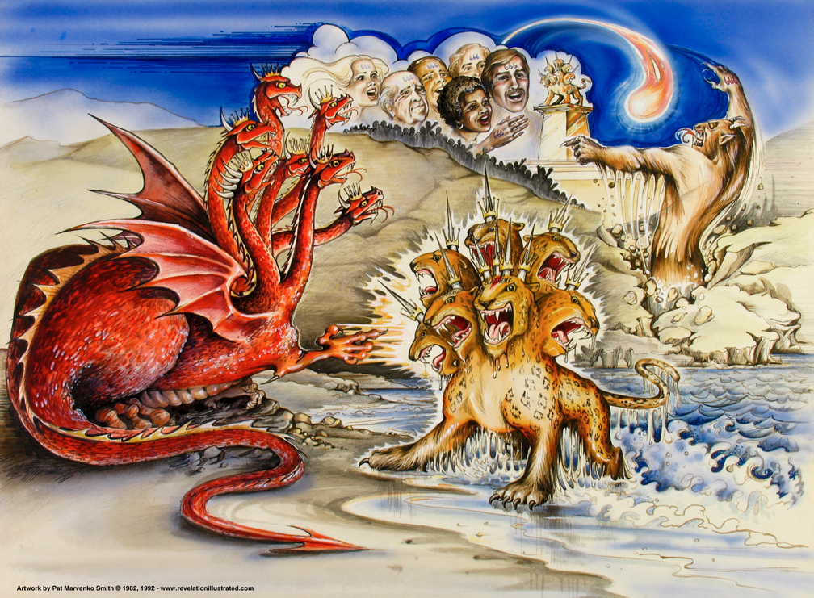
Book of Revelation: Chapter 13
The Battle: Forces of the Conflict
Satan’s Agents – The Two Beasts

Slide 9

Revelation 13:1
Revelation 13
“and he stood upon the sand of the sea. And I saw a beast coming up out of the sea, having ten horns, and seven heads, and on his horns ten diadems, and upon his heads names of blasphemy.”

Slide 10
Satan and His Evil Forces
Revelation 13
Beast out of the sea – political power from the mass of humanity.
“Sea” – cf. Revelation 8:8; 10:2, 8; 12:12; 13:1; 20:13; 21:1
Its origin and appearance – indescribable horror
“He stood on the sand,” dragon awaiting his henchmen (cf. Translations: “He stood …” “I stood …” )
“Coming up out of the sea,” the sea of humanity (Isaiah 17:12) Note similar characteristics of the dragon (12:3)
Having: Ten horns (great power); complete strength, which was given by Satan!

Slide 11
Satan and His Evil Forces
Revelation 13
Beast out of the sea – political power
Its origin and appearance – indescribable horror
“Seven heads,” perfect authority as it was given to him by Satan
“Ten diadems” on his horns. (Satan has them on his head – 12:3) Satan is the true power behind the beast’s royalty.
In either case, the crowns (diademata) portray the idea of royalty and great authority. Not the victory crown (stéphanos).
“Blasphemous names” on his heads instead of crowns; to blaspheme God and His saints. (cf. Daniel 7:7-8, 11, 17-27, especially verse 25).

Slide 12
Revelation 13:2
Revelation 13
“And the beast which I saw was like unto a leopard, and his feet were as (the feet) of a bear, and his mouth as the mouth of a lion: and the dragon gave him his power, and his throne, and great authority.”
Daniel 7:3-7

Slide 13
What the Beast Was “Like”
Revelation 13
The beast was “like” (represents the Roman Empire)
John sees a combination / composite of the features of the four wild beasts in Daniel’s vision. (Daniel 7:3-7)
“A leopard”
“Feet of a bear”
“Mouth of a lion”

Slide 14
What the Beast Was “Like”
Revelation 13
The beast was “like” (represents the Roman Empire)
“Leopard:” “cat-like quickness” to conquer the world with speed. (Grecian army)?
“Feet of a bear:” awesome power to trample the enemy. (Medes; Persians)?
“Mouth of a lion:” a nation’s ability to conquer; to prey like a lion. (Roman Empire)?

Slide 15
The Dragon – Power Behind the Beast!
Revelation 13
The “Dragon” gave the “Beast:”
“Power” – the real power behind the empire was Satan; he delegated that power to Rome.
“His seat” – the ability to act
“Great authority” – remember, Satan’s authority is limited. (Daniel 4:17).
Luke 4:6
John 12:31; 14:30; 16:11
2 Corinthians 4:4
Ephesians 2:2
Satan is still
“the prince of this world”

Slide 16
Revelation 13:3
Revelation 13
“And (I saw) one of his heads as though it had been smitten unto death; and his death-stroke was healed: and the whole earth wondered after the beast”

Slide 17
Revelation 13:4
Revelation 13
“and they worshipped the dragon, because he gave his authority unto the beast; and they worshipped the beast, saying, Who is like unto the beast? And who is able to war with him?”
Dragon

Slide 18
Wound and Recovery
Revelation 13
In John’s day, the beast embodied the form of the Roman Empire.
Satan has always used men’s kingdoms as instruments against God’s reign.
He cannot win, since “God rules in the kingdoms of men” (Daniel 4:17).
Only the Lamb has power to overcome the beast (19:20).
“One” of the beast’s heads was wounded unto death, but since he had seven, his life was not taken!

Slide 19
Wound and Recovery
Revelation 13
Many suggest that the “wounded head” was Nero; he took his own life in 68 AD. After Nero, the empire suffered a two year period of anarchy and confusion.
Order was restored by Vespasian, but the healing of the death-stroke meant persecution for Christians. (cf. Hailey, page 286)
Persecution did ease somewhat after Nero’s death, but it revived under Domitian (81–96 AD) (cf. Nero redivivus myth)
Another thought … The seven heads represent Rome – the world power in control. In time, Rome would be fatally wounded, but another nation would rise up and replace her – repeating the cycle … (I don’t think so! Daniel 7; Revelation 19:19-20)

Slide 20
Wound and Recovery
Revelation 13
The beast seems invincible. Causes all the “world” (outside of Christ) to marvel and adore him.
By subjecting itself to the beast’s demands, the world is actually worshipping Satan.
Enamored by the beast’s power, authority, and earthly wealth, they eagerly follow him …
Nothing is comparable (so they think).
Nothing can make war and succeed (so they think).

Slide 21
Revelation 13:5
Revelation 13
“and there was given to him a mouth speaking great things and blasphemies; and there was given to him authority to continue forty and two months.”
cf. Daniel 7:8,11,25
Revelation 11:3; 12:6, 14; 13:5; cf. Daniel 7:25

